Slide 1
Linear Algebra
Lecture 12

Slide 2
Segment II

Slide 3
Matrix
Algebra

Slide 4
Inverse of
a Matrix

Slide 5
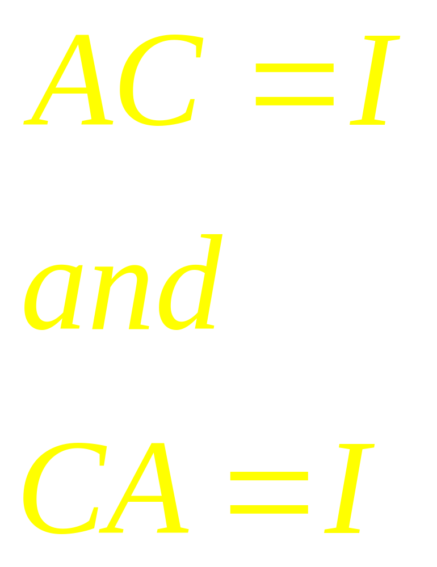

Slide 6
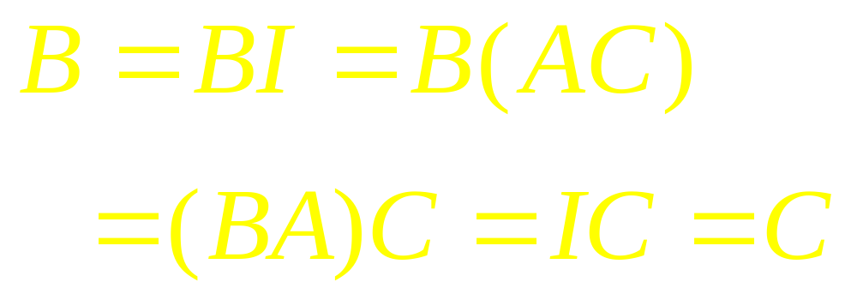
Inverse is Unique

Slide 7
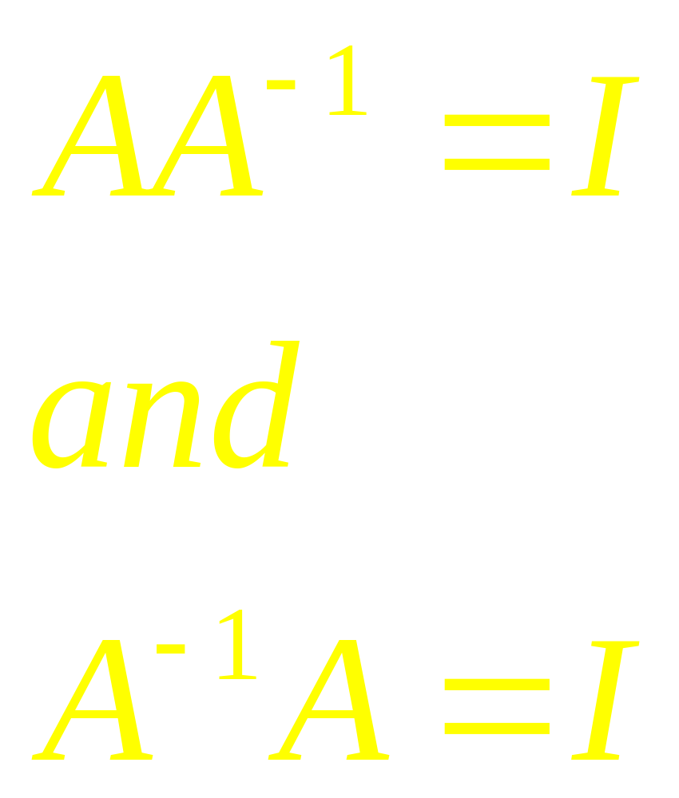
Convention

Slide 8
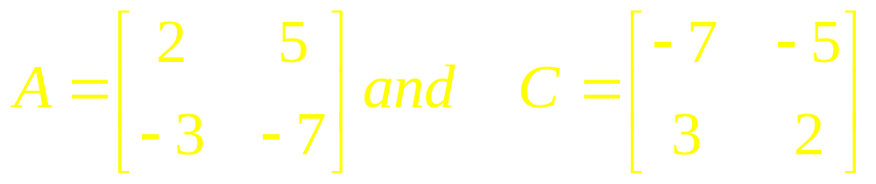
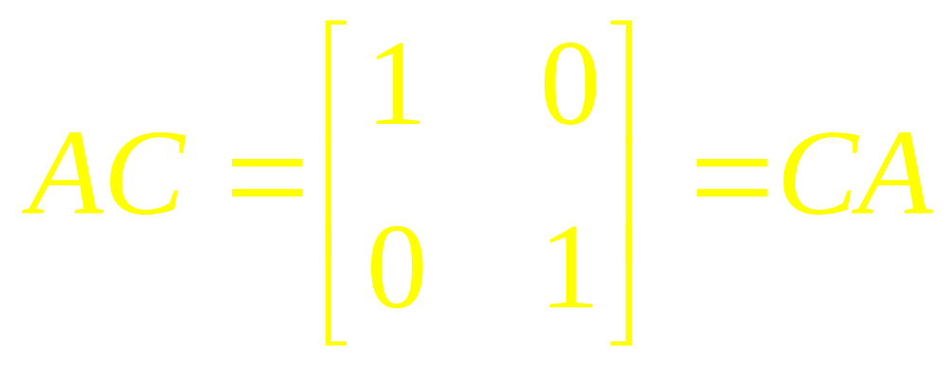
Example 1

Slide 9
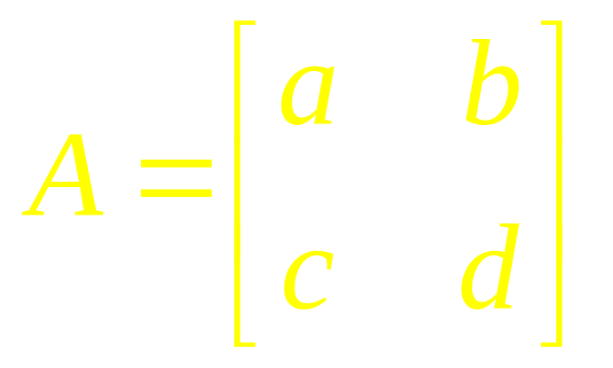

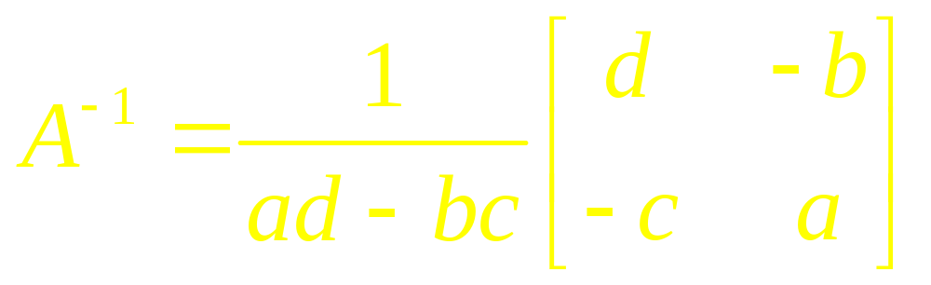
Theorem

Slide 10
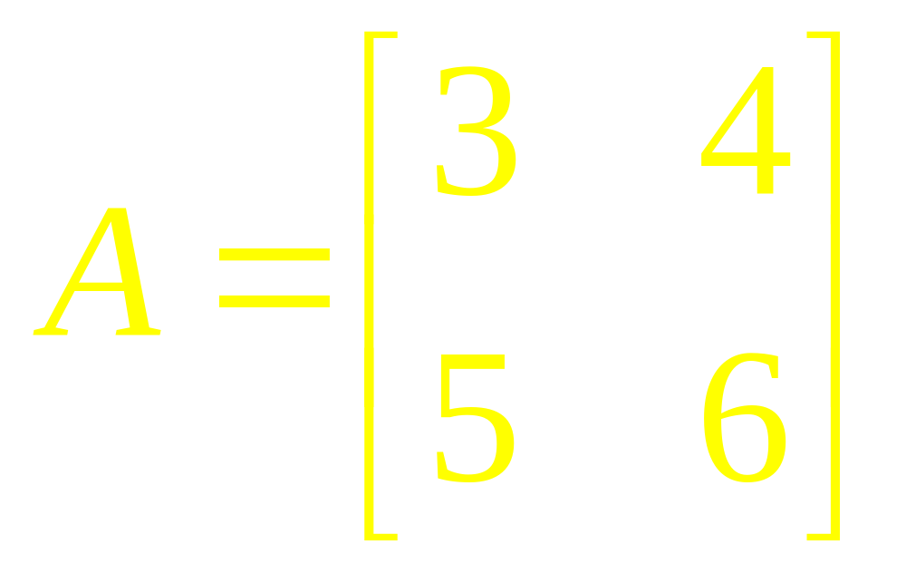
Example 2
Find the Inverse of

Slide 11
Theorem

Slide 12
Inverse of
a Tranpose

Slide 13
Inverse of
a Product

Slide 14
Elementary
Matrices

Slide 15
Inverse
Operations

Slide 16
Theorem
An elementary Matrix is invertible and the inverse is also an elementary matrix

Slide 17
Left Multiplication

Slide 18
Theorem

Slide 19
Algorithm

Slide 20
Examples

Slide 21
Quick
Revision

Slide 22
Linear Algebra
Lecture 12

